Slide 1
Software Architecture
Created By Rahul Majukar

Slide 2

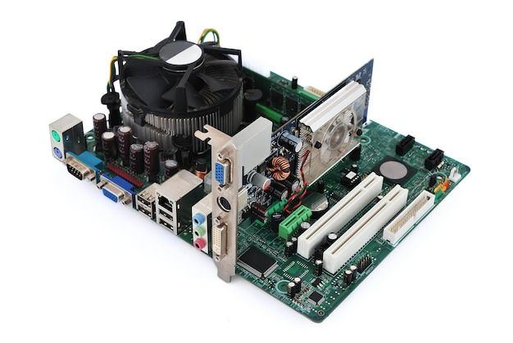
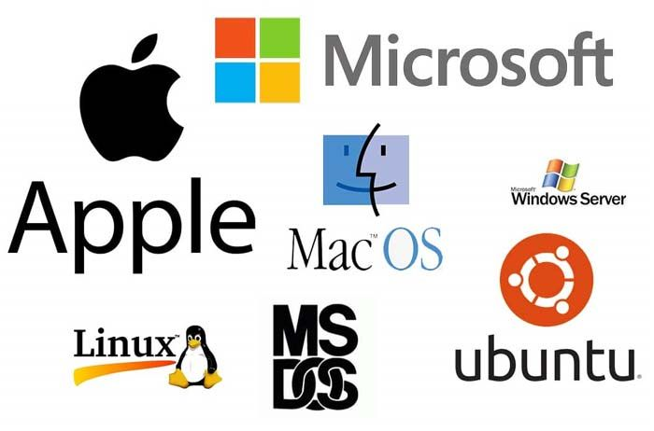
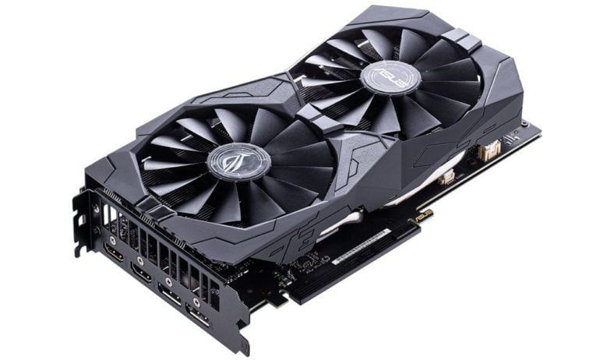
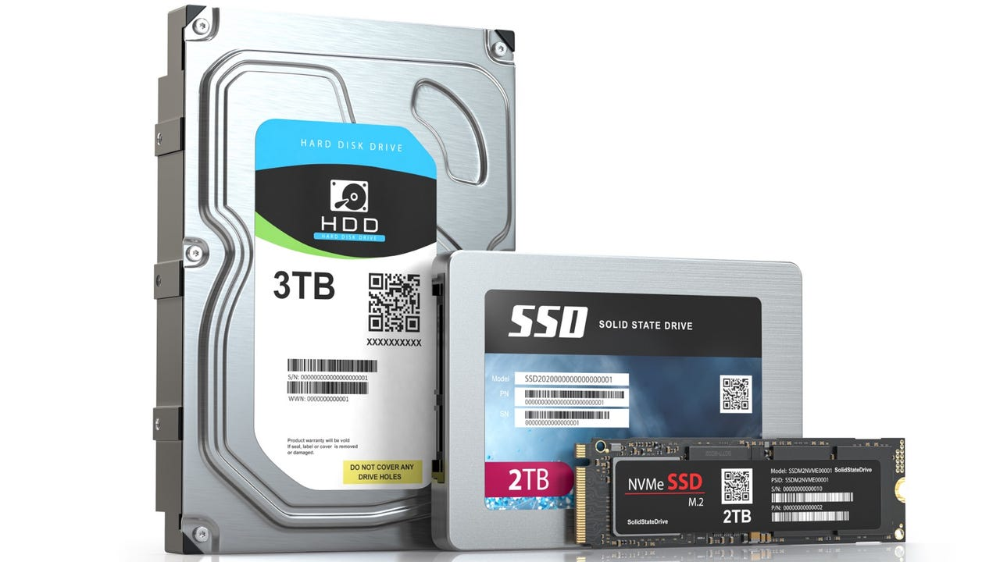
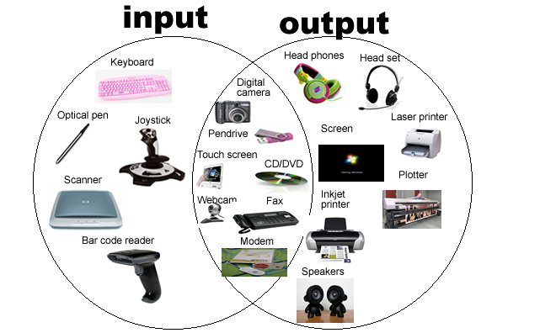
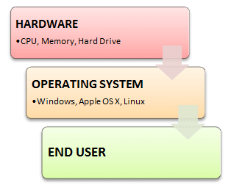
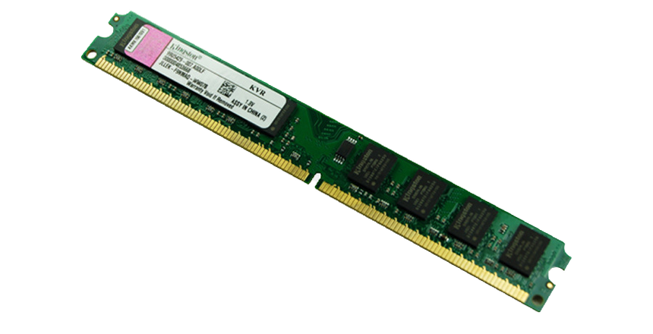
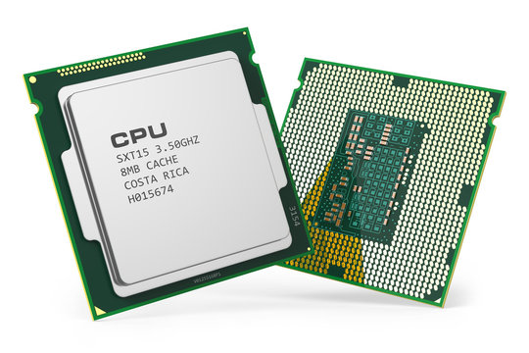
Components of Computer
Subscribe
HackifyTech
Like & Follow
Central Processing Unit (CPU):
Memory (RAM):
Storage Devices (HDD, SSD):
Motherboard:
Power Supply Unit (PSU):
Graphics Processing Unit (GPU):
Input Devices (Keyboard, Mouse, Touchpad/Trackpad, Touchscreen):
Output Devices (Monitor, Printer, Speakers):
Operating System(OS): understand only 0 and 1

Slide 3
Components of Computer
Subscribe
HackifyTech
Like & Follow
Programming languages are all about making things understandable to computers so that humans can connect with the system. However, computers only understand only two letters (0,1).
So the developers create a compiler in all of the programming languages, which is what we term translator between human understandable language/high level language to machine language (0,1).
HLL
1 + 1 =
Translator
1001001
MLL(0,1)
Human understandable
Language
Compiler/Interpreter

Slide 4
What is Programming language
Subscribe
HackifyTech
Like & Follow
Programming Language: set of instructions that a computer can interpret and execute to perform specific tasks.
High-Level Programming Languages:
Examples: Java, Python, C++, JavaScript, Ruby.
These languages are designed to be human-readable

Slide 5
Types of Programming language
Subscribe
HackifyTech
Like & Follow
Compiled Languages:
Source code(HLL)
Complier
Byte Code(ALL)
Interpreter
Output(MLL)
Examples of Compiled Languages:
Java, C, C++, Rust, Go, Swift.
Interpreted Languages:
Source code(HLL)
Complier
Interpreter
Output(MLL)
Examples of Interpreted Languages:
Python(complied & interpreted), JavaScript, Ruby, PHP.

Slide 6

MVC Architecture
A website is a collection of web pages hosted on the Internet that provides information, services, or resources to users, typically accessed through a web browser using a unique domain name.
Subscribe
HackifyTech
Like & Follow
Front End
Website
Mobile App
Software

Slide 7
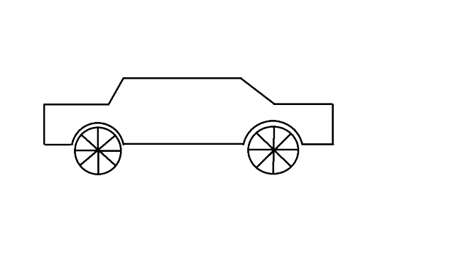
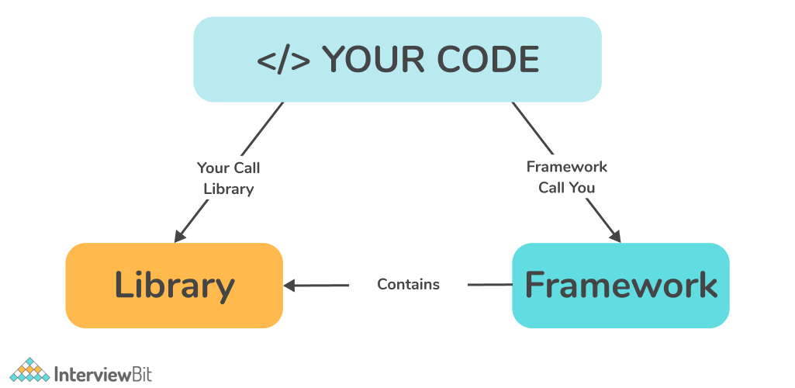
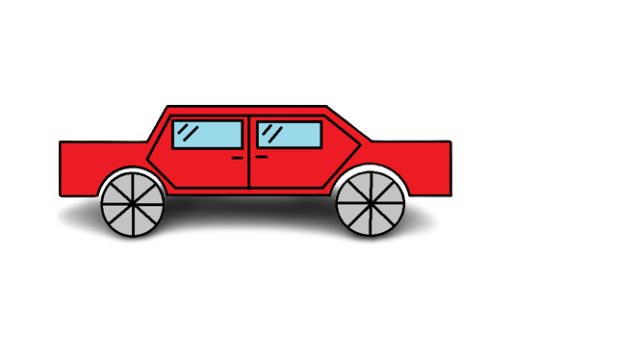

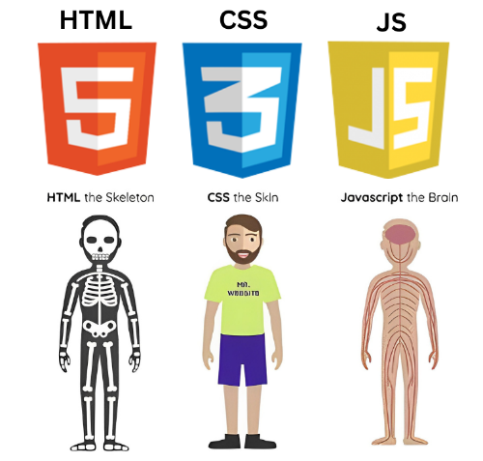
MVC Architecture
Subscribe
HackifyTech
Like & Follow
Front End
HackifyTech
HTML
CSS
JavaScript
FW: Angular
FW: VUE.js
Lib: React

Slide 8
MVC Architecture
Subscribe
HackifyTech
Like & Follow
Front End
Back End
HackifyTech
HTML
CSS
JavaScript
FW: Angular
FW: VUE.js
Lib: React
Java (Spring boot, Quarkus)
Python (Django, Flask, FastAPI)
Node js (Express.js,Koa.js)
C# (ASP.net)
PHP (Laravel)
Etc..
Question:
1.Why we need separate front and backend

Slide 9
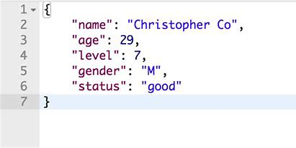
MVC Architecture
Subscribe
HackifyTech
Like & Follow
Front End
Back End
Data Base
HackifyTech
HTML
CSS
JavaScript
FW: Angular
FW: VUE.js
Lib: React
Java (Spring boot, Quarkus)
Python (Django, Flask, FastAPI)
Node js (Express js)
C# (ASP.net)
PHP (Laravel)
Etc..
RDBMS
ex:
i. MySQL
ii. oracle
iii. PostgreSQL
NRDBMS
i. Mangodb
ii. Redix
iii. HBase

Slide 10

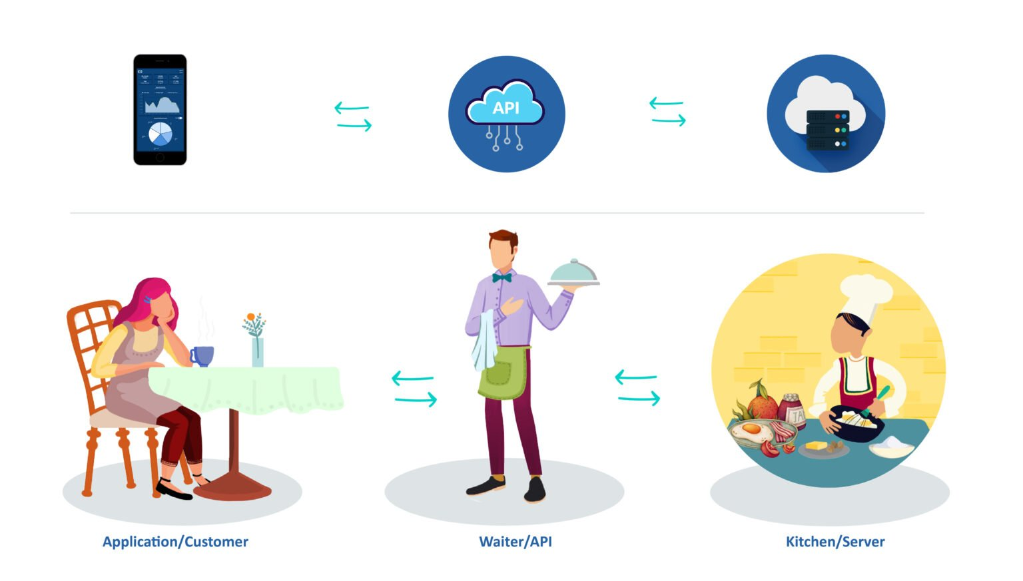
MVC Architecture
Subscribe
HackifyTech
Like & Follow
Front End
Request
Back End
Response
API’s
HackifyTech
HTML
CSS
JavaScript
FW: Angular
FW: VUE.js
Lib: React
Java (Spring boot, Quarkus)
Python (Django, Flask, FastAPI)
Nodejs (Express js)
C# (ASP.net)
PHP (Laravel)
Etc..
Notes: i. The front end and backend could be on different server
ii. The Communication from front end and backend with API’s

Slide 11
MVC Architecture
Subscribe
HackifyTech
Like & Follow
Request
API: Application programming Interface
It’s all about request and response, and the data sharing is done in JSON format.
JavaScript Object Notation
Front End
Back End
Response
API’s
HackifyTech
HTML
CSS
JavaScript
FW: Angular
FW: VUE.js
Lib: React
Java (Spring boot, Quarkus)
Python (Django, Flask, FastAPI)
Nodejs (Express js)
C# (ASP.net)
PHP (Laravel)
Etc..
Notes: i. The front end and backend could be on different server
ii. The Communication from front end and backend with API’s

Slide 12
MVC Architecture
Subscribe
HackifyTech
Like & Follow
View
Controller
Model
Front End
Request
Back End
Request(Queries)
Data Base
Response
Response(data)
HackifyTech
HTML
CSS
JavaScript
FW: Angular
FW: VUE.js
Lib: React
Java (Spring boot)
Python (Django, Flask)
Node js (Express js)
C# (ASP.net)
PHP (Laravel)
Etc..
RDBMS
ex:
i. MySQL
ii. oracle
iii. PostgreSQL
NRDBMS
i. Mangodb
ii. Redix
iii. HBase
Notes: i. The Communication from front end and backend with API’s
ii. The front end and backend could be on different server

Slide 13
Subscribe
HackifyTech
Like & Follow

